Slide 1
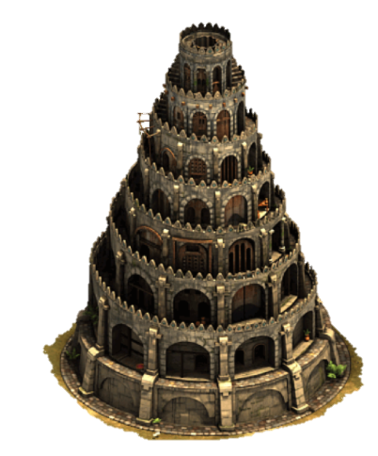
Castle Defense
Group 3D
Xhoana ALIU 21500429 Muhamed KETA 21503560 Onur KOCAHAN 21402013 Mehmet Can ALTUNTAS 21501883

Slide 2
Castle defense
The aim is to defeat all the creeps and not let them surpass the castle’s gates
The game will be played by using the mouse and the keyboard will be used to enter the player’s name in order to save it in high scores table.
The game will be implemented in Java and it will be a desktop application.

Slide 3
Game Play
Different types of towers with different features and different price that can be bought sold and upgraded
Basic Tower,
Ice Tower
Explosive Tower
Poison Tower

Slide 4
Game Play
Waves of many enemy creeps of different kinds with various strength, speed and health meter
Speedy Gonzales
Iron Back
Viper
Boss

Slide 5
Game Play
Consumables to be used by the user in order to help defeat the invaders of the castle
Stun
Bomb
Glue

Slide 6
Game Play
Towers and consumables can be bought by using the coins that will be gained during the games.
High sores of the player will be saved so s/he can see her/his progress
Procedurally generated maps so that every new game can offer a new experience
The came can be saved to be played another time by the user

Slide 7
Game Play
There will be 3 different levels: Easy, Normal and Hard.
More difficult levels will offer more waves with more creeps.

Slide 8
Project Progress
Model classes, Random Map generator classes and some of the menu classes are finished (But not fully developed thus there will be further improvements)
Tower Store class, High Scores class and Animations are not done yet
Control classes are not fully developed
The integration of the code done so far is not quite finished

Slide 9
Team Work and Changes
We have tried to divide the tasks so everyone can work separately and in the end the codes each of one writes can be easily integrated.
There are not a lot of changes from the reports done before however during implementation we have done some changes to the methods and attributes of the classes in order to make the project more efficient and with higher performance.
Save and Load Game: We decided to implement these two options in a menu bar at the game window since it would make it easier and more accessible for the player to choose between different options.

Slide 10
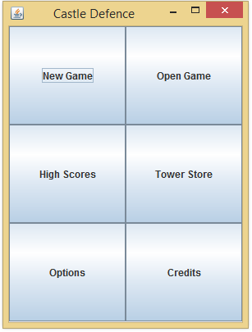
Game Main Menu

Slide 11
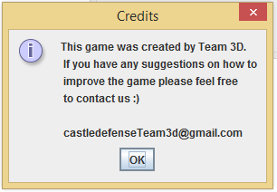
Credits

Slide 12
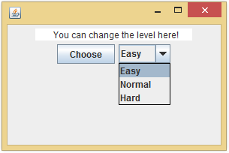
Options

Slide 13
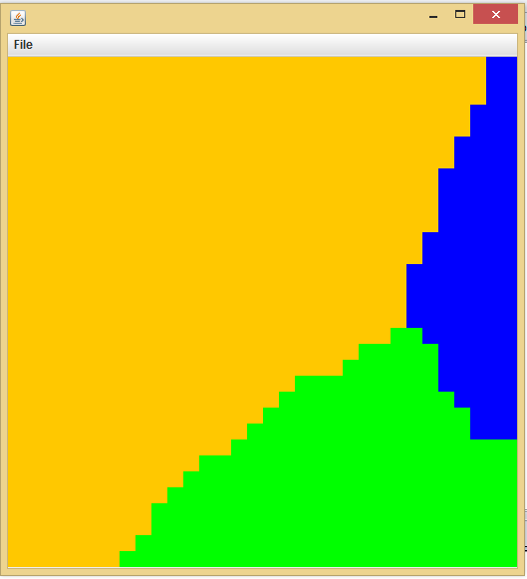
Game Map

Slide 14
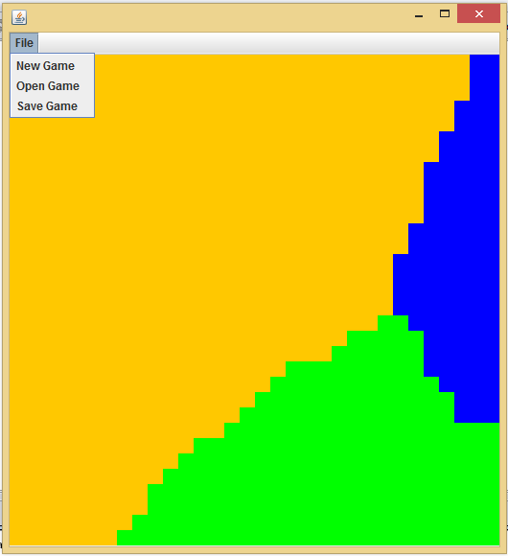
New/ Save/ Load Game

Slide 15
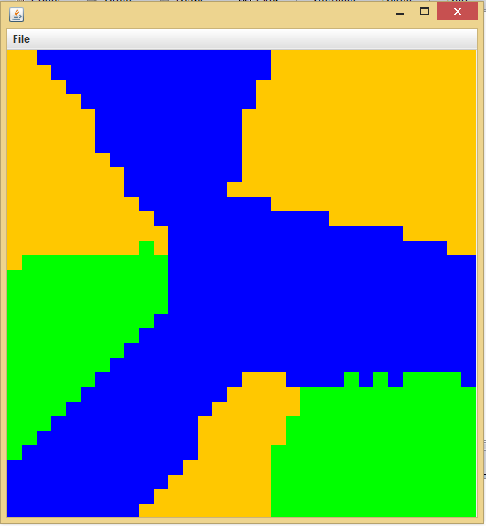
New Game

Slide 16
Thank you!

